Slide 1

Customer Churn Analysis
Data-driven insights to reduce churn and boost retention

Slide 2
OVERVIEW
The Challenge
7,043
26.5%
1,869
Total Customers
Churn Rate
Churned
1 in 4 customers leave
Critical Business Impact
Customer churn directly impacts revenue and long-term growth. Analysis of 21 features reveals key drivers of customer departure.
Demographics and service usage patterns
Contract types and billing methods
Payment behavior analysis

Slide 3



KEY FINDING #1
Contract Type Drives Churn
42.7%
11.3%
2.8%
Month-to-Month
One-Year
Two-Year
Highest risk group
Moderate stability
Highest loyalty
Long-term contracts show dramatically lower churn. Month-to-month customers are 15x more likely to leave than two-year contract holders.

Slide 4
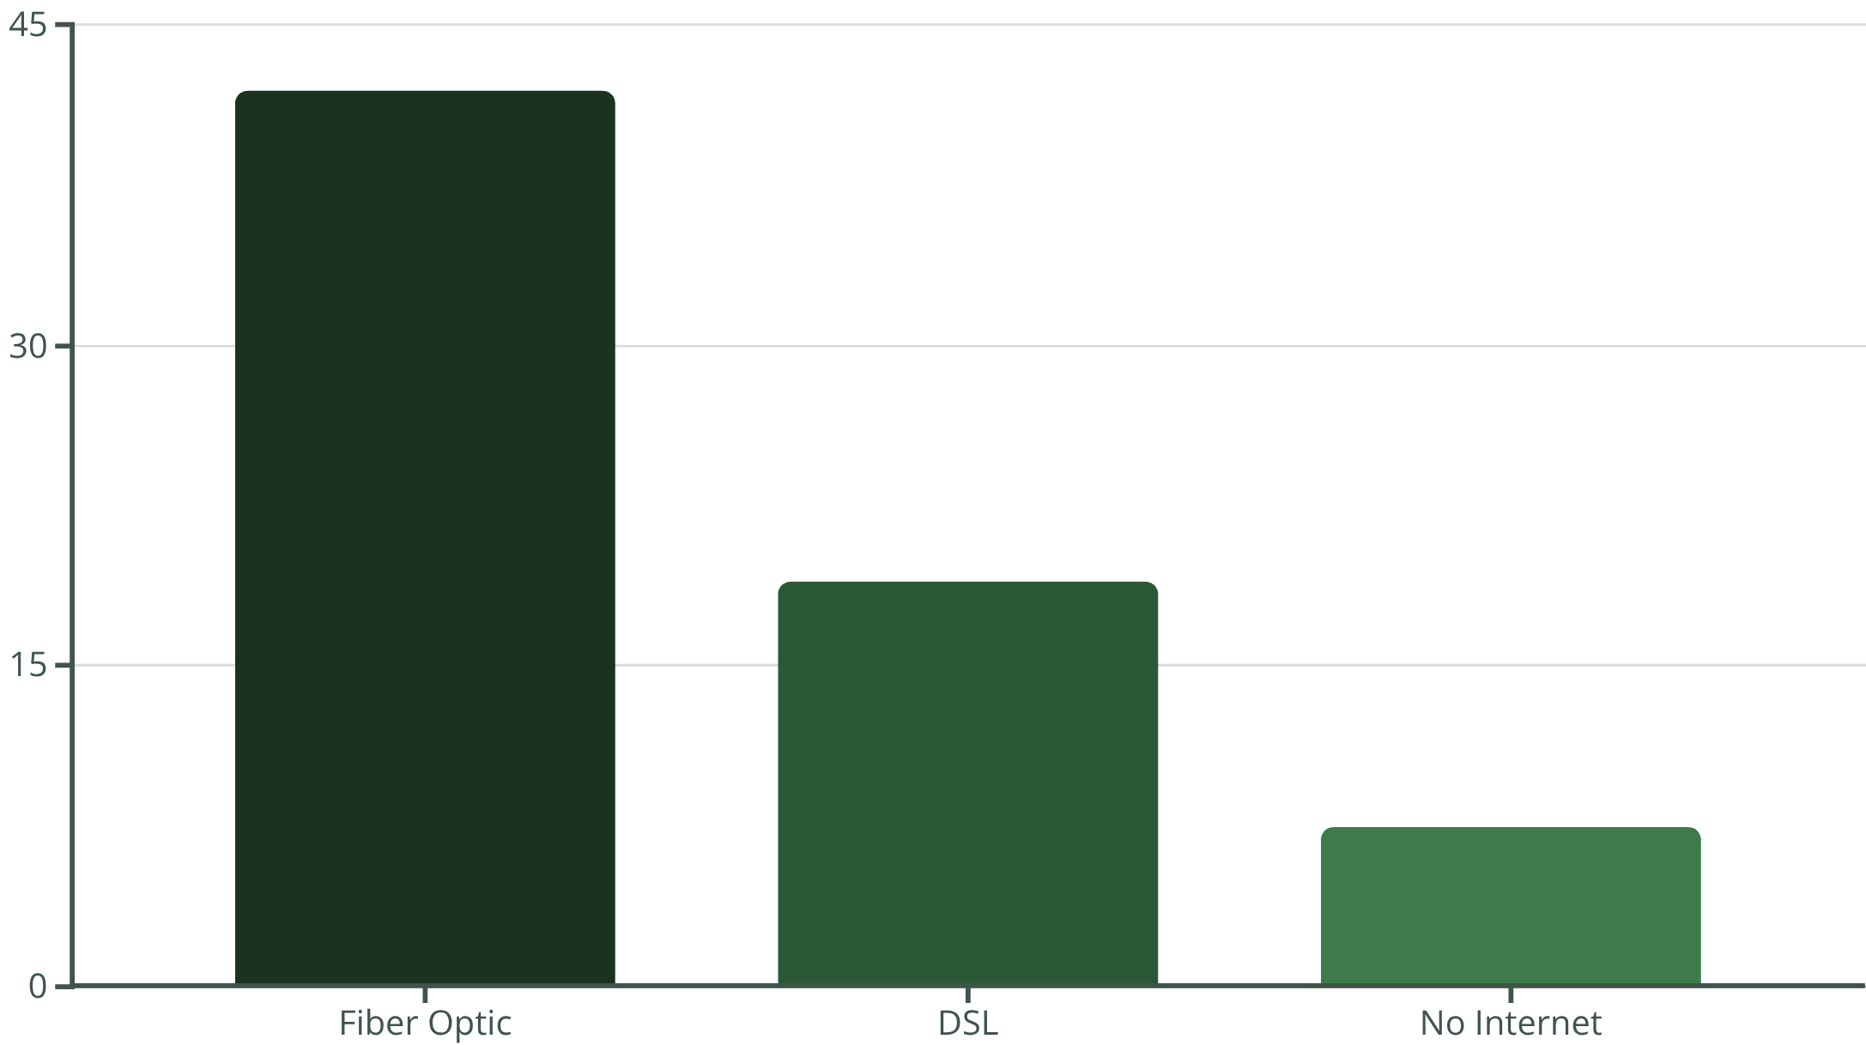

KEY FINDING #2
Service Type Paradox
Premium Service, Higher Churn
Fiber optic users churn at 41.9% — more than double DSL customers.
Suggests issues with pricing, service quality, or unmet expectations in premium tier

Slide 5

KEY FINDING #3
Demographics Matter
Senior Citizens
Non-Seniors
41.7% churn rate
23.6% churn rate
Almost double the average
Below average churn
Senior citizens require simplified plans and enhanced support to improve retention.

Slide 6
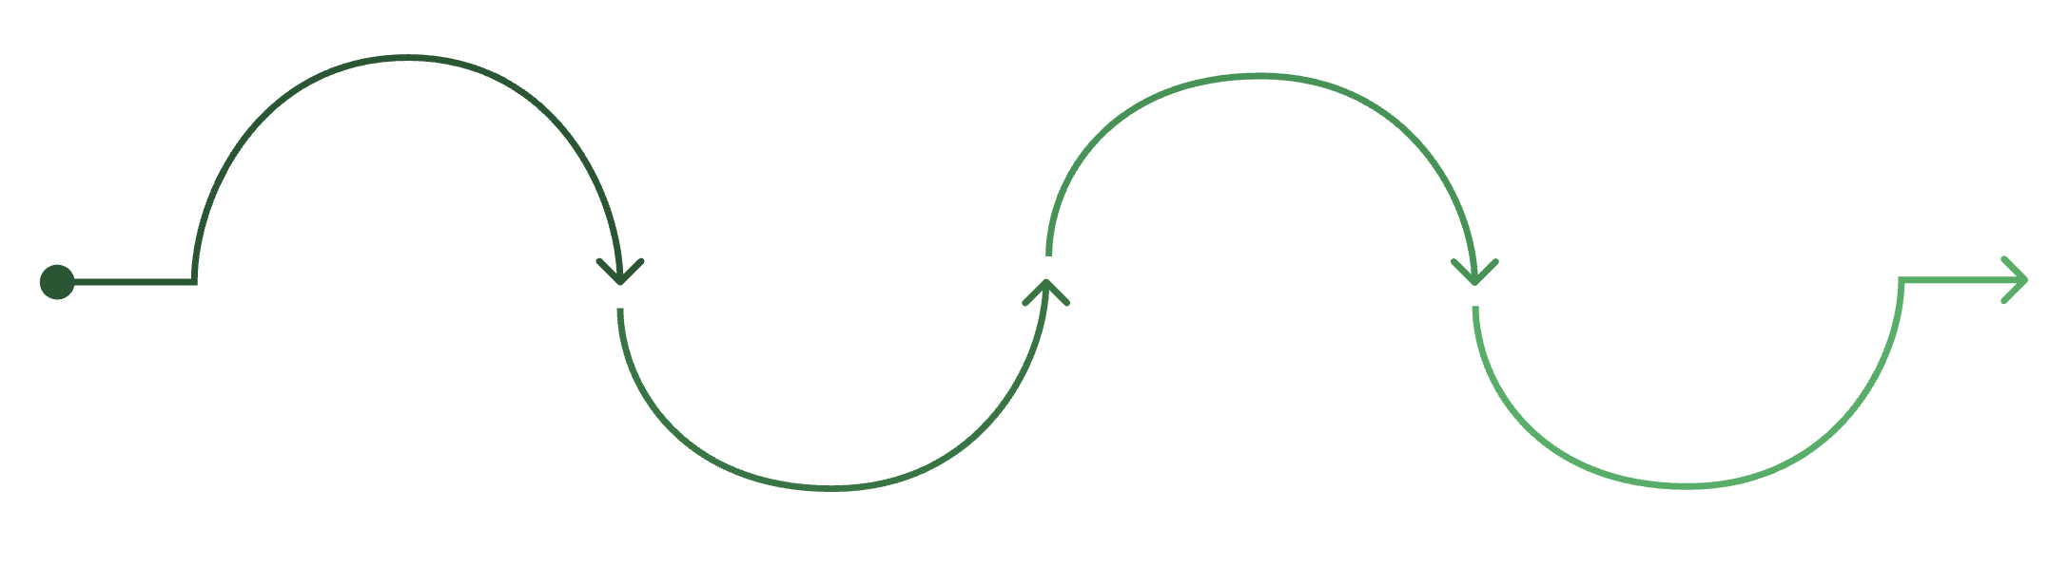
KEY FINDING #4
Tenure Timeline
New Customers at Highest Risk
Churn decreases dramatically with tenure. First year is critical for retention.
12-24 months
48-72 months
0-12 months
24-48 months
Highest risk — 47.7% churn
Significant drop — 28.7% churn
Lowest risk — 9.5% churn
Further decline — 20.4% churn
47.7% of customers churn within their first year

Slide 7

KEY FINDING #5
Payment Method Impact
Electronic Check
Auto-Pay
Paperless + Monthly
More stable customers
Higher churn risk
Increased churn risk
Bank transfer & credit card
Manual payment friction
Combination effect

Slide 8





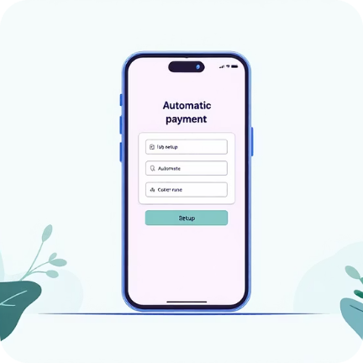
SOLUTIONS
Strategic Recommendations
Early Engagement
Promote Long-Term
Improve Fiber Service
Senior Strategy
Strong 90-day onboarding with regular follow-ups and loyalty benefits
Discounts and bundled add-ons for 1-year and 2-year contracts
Monitor quality, address complaints, align promises with delivery
Simplified plans, dedicated support, transparent pricing
Optimize Payments
Incentivize auto-pay, reduce electronic check dependency

Slide 9




IMPACT
Expected Business Outcomes
5-10% Churn Reduction
Improved CLV
Revenue Growth
Immediate Benefits
Long-Term Value
Reduced acquisition costs
Higher customer satisfaction
Stronger loyalty metrics
Sustainable revenue streams
Competitive advantage
Enhanced profitability

Slide 10

Key Takeaways
01
02
Contract duration is the strongest predictor
First year is critical
Month-to-month customers need immediate attention
47.7% of churn happens in first 12 months
03
04
Premium service needs improvement
Personalization drives retention
Fiber optic users show unexpected high churn
Targeted strategies for seniors and payment optimization
Focus on early engagement, long-term contracts, and personalized retention to significantly reduce churn and improve profitability.

